Slide 1


K.L.E Society’s
KLE College of Engineering and Technology, Chikodi
DEPTARTMENT OF ELECTRONICS AND COMMUNICATION ENGINEERING
Since 1946
TAXI FARE METER
Mini-project on: 2022-07-18
NAME OF THE STUDENT | USN
Chandrashekhar Bhajantri | 2KD19EC010
Kunal Dilza | 2KD19EC016
Mahammadmustaf Hadimani | 2KD19EC019
Rakesh Patil | 2KD19EC034
Under the Guidance of:
Prof. Praveen Gurav
Assistant Professor, Dept. of ECE

Slide 2
Contents:
INTRODUCTION
OBJECTIVES
COMPONENTS SPECIFICATIONS
CIRCUIT DIAGRAM
EXPECTED OUTPUT
APPLICATIONS
CONCLUSION
: Taxi Fare Meter

Slide 3
INTRODUCTION
As there is advancement in technologies, we are going to implement a device which tells us the fare based on distance.
Taximeters were originally mechanical and mounted outside the cab, above the driver's side front wheel. Meters were soon relocated inside the taxi, and in the 1980s electronic meters were introduced, doing away with the once-familiar ticking sound of the meter's timing mechanism.
Taximeter is an adaptation of the German word Taxameter, which is itself a variant of the earlier German word Taxanom.
Taxe is a German word meaning "tax", "charge", or "scale of charges". The Medieval Latin word taxa also means tax or charge.
In this era of almost everything being digitalized. So we are replacing analog fare meter in taxi by digital fare meter using Arduino to make the process more efficient and reliable.
In digital meter, instead of using mechanical parts, some sensors like Proximity and DHT11 sensor are included which is used to calculate distance and measure Temperature and Humidity of the surrounding respectively.
This is more accurate than analog meters and doesn’t require any maintenance for long period of time.
: Taxi Fare Meter

Slide 4
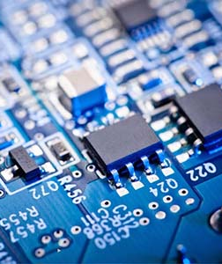
OBJECTIVES
Our objective of this study is to be able to make a fare meter for vehicle that can compute the amount due to passengers which corresponding to distance travelled. It is composed of:
Ø A microcontroller
Ø A LCD
Ø A Proximity sensor
Ø DHT11 Sensor
More specifically ,our study aims to:
Ø Set parameter & techniques
Ø Come up with a fare rate

Slide 5
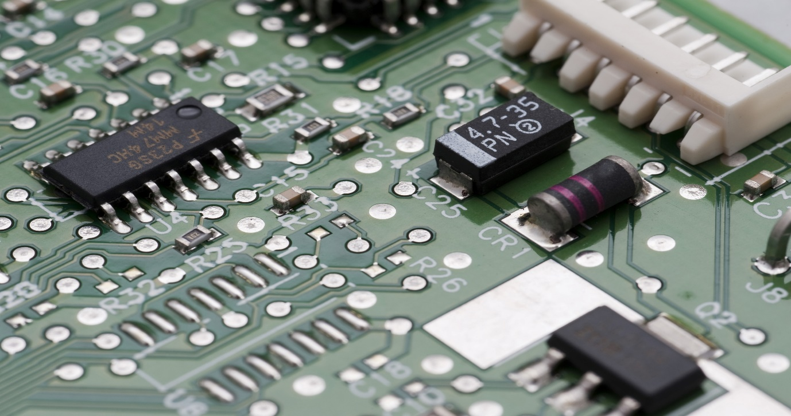
COMPONENTS USED:
Arduino Uno R3
Inductive Proximity Sensor
DHT11 Temperature and Humidity Sensor
LCD 16*2
Breadboard
Jumper wires
Resistors
Potentiometer
: Taxi Fare Meter

Slide 6

ARDUINO UNO
ATmega328P
Memory
AVR CPU at up to 16 MHz
32KB Flash
2KB SRAM
1KB EEPROM
Security
Power On Reset (POR)
Brown Out Detection (BOD)
The brown out detector will put the chip into reset mode if the voltage on the Vcc pin drops below the threshold. When in reset, all GPIO pins go into high impedance mode and no code executes.
BOD will either reset the system/ raise the hardware interrupt for safe power down sequence.
A power-on reset (PoR) is a circuit that provides a predictable, regulated voltage to a microprocessor or microcontroller with the initial application of power. The PoR system ensures that the microprocessor or microcontroller will start in the same condition every time that it is powered up.
: Taxi Fare Meter
6

Slide 7
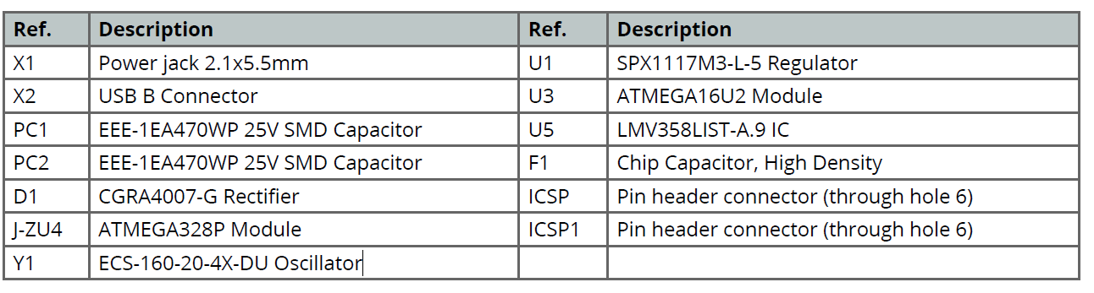
: Taxi Fare Meter

Slide 8
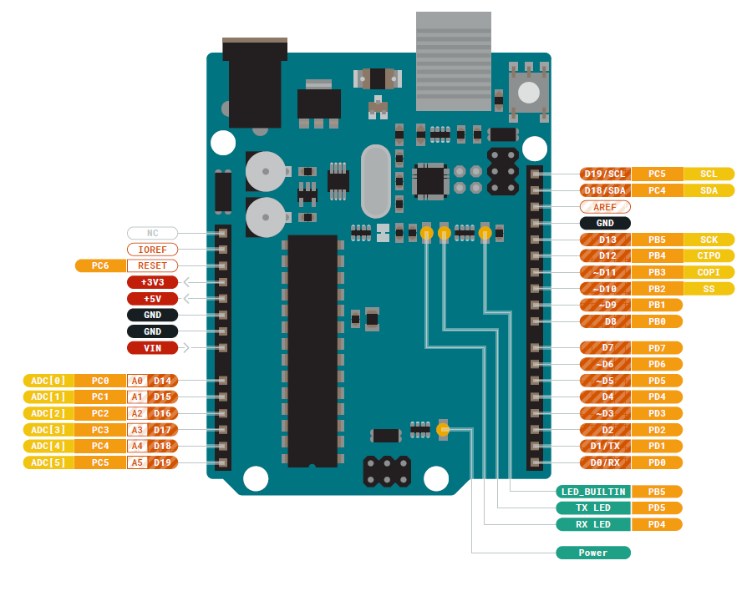
: Taxi Fare Meter

Slide 9
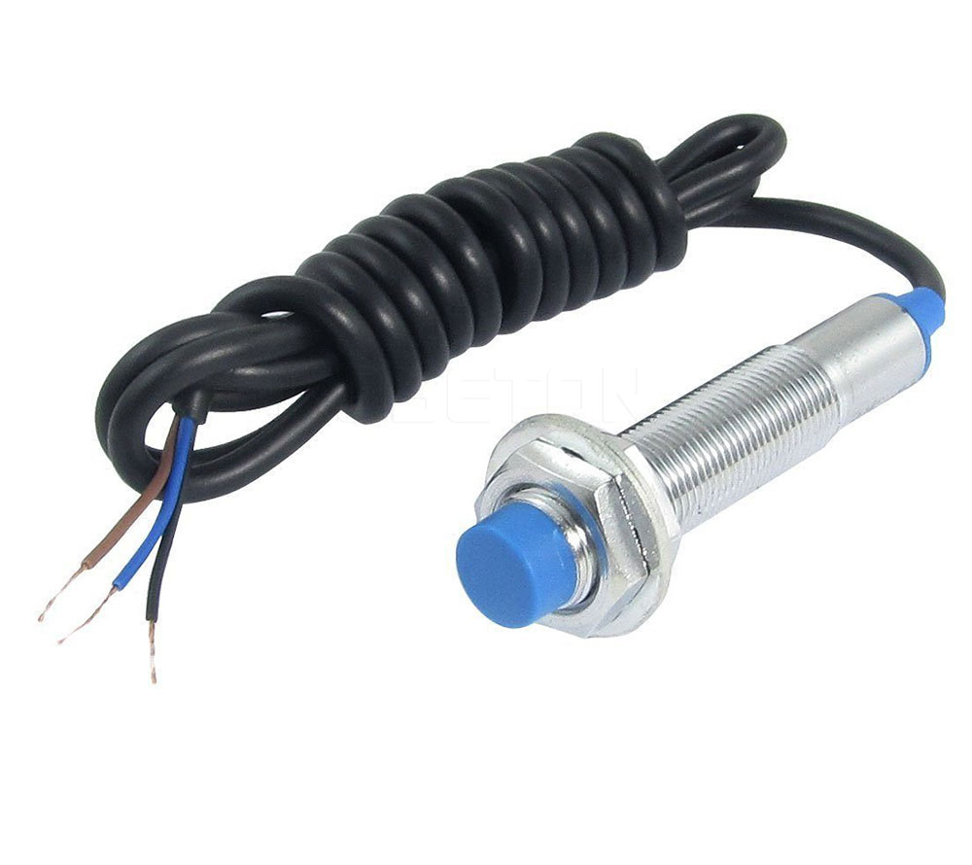
Inductive Proximity Sensor:
This sensor can only detect metal targets.
Depending on the type of proximity sensor, sound, light, infrared radiation (IR), or electromagnetic fields may be utilized by the sensor to detect a target.
Proximity sensors are used in phones, recycling plants, self-driving cars, anti-aircraft systems, and assembly lines.
There are many types of proximity sensors, and they each sense targets in distinct ways.
The two most commonly used proximity sensors are the inductive proximity sensor and the capacitive proximity sensor.
: Taxi Fare Meter

Slide 10
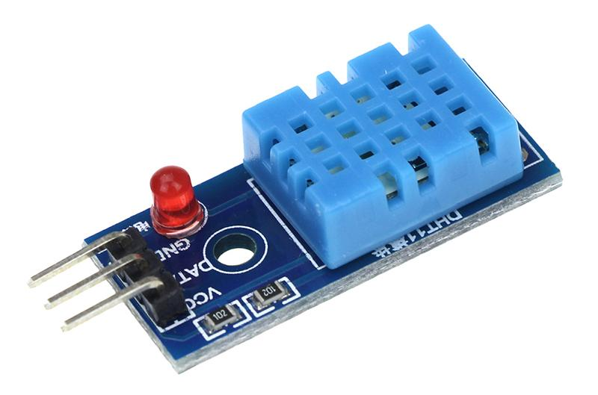
DHT11 Sensor:
The DHT11 is a basic, ultra low-cost digital temperature and humidity sensor.
It uses a capacitive humidity sensor and a thermistor to measure the surrounding air, and spits out a digital signal on the data pin .
Its fairly simple to use, but requires careful timing to grab data. You can get new data from it once every 2 seconds.
APPLICATIONS:
Used in Ventilation and Air Conditioning.
Home Automation Systems.
Weather Stations.
: Taxi Fare Meter

Slide 11
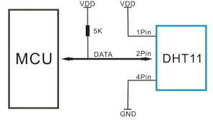
Block Diagram:
DHT11 Sensor has 3 Pins, namely VCC/VDD , GND and a data pin.
The 1st Pin is connected to the +5V of Vcc source.
3rd Pin is connected to Gnd of power source.
Here in our circuit we use 2nd Pin, i.e Data pin is connected to the Data pin 13 of Arduino.
Our Arduino Board has a built in Processor widely called as ATMEGA 328P. Hence the Data pin of DHT11 is connected to the Processor.
: Taxi Fare Meter

Slide 12
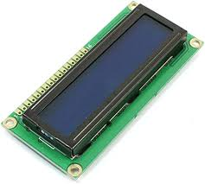
LCD Display:
An LCD (Liquid Crystal Display) screen is an electronic display module and has a wide range of applications. A 16x2 LCD means it can display 16 characters per line and there are 2 such lines. In this LCD each character is displayed in 5x7 pixel matrix. The 16 x 2 intelligent alphanumeric dot matrix display is capable of displaying 224 different characters and symbols. This LCD has two registers, namely, Command and Data.
Command register stores various commands given to the display. Data register stores data to be displayed. The process of controlling the display involves putting the data that form the image of what you want to display into the data registers, then putting instructions in the instruction register.
In your Arduino project Liquid Crystal Library simplifies this for you so you don't need to know the low-level instructions. Contrast of the display can be adjusted by adjusting the potentiometer to be connected across V0 pin.
: Taxi Fare Meter

Slide 13
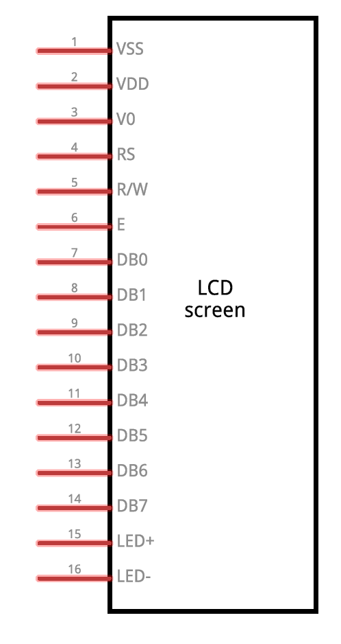
Block Diagram:
PIN1:VSS- This is a Ground Pin of LCD which is connected to the power source.
PIN2:VDD- This is Supply voltage pin of LCD connected to power source.
PIN3:V0- It is the pin used to adjust the contrast of LCD display.
PIN4:RS- This pin is Register Select, which is used to toggle between command or data register.
PIN5:R/W- This pin toggles the LCD between Read/Write Operation.
PIN6:E- This pin must be held high to perform read or write operation.
PIN7-14: These pins are data/command pin because these are used to send data/command to LCD.
PIN15:LED+ This pin is used to do operation to illuminate LCD.
PIN16:LED- This pin is used to do operation to illuminate LCD connected with GND.
: Taxi Fare Meter

Slide 14
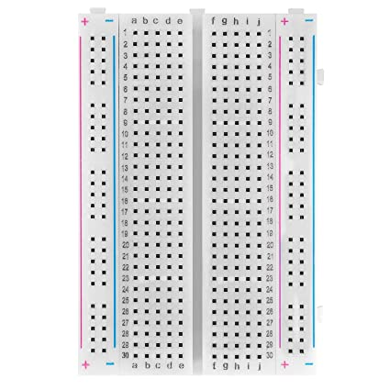
Other Components:
Breadboard (plugboard) has sets of miniature sockets laid out on a 0.1 inch grid which will accept the manual insertion of component leads and tinned copper wire (TCW) links .
It has rows of contacts interconnected in groups placed either side of the center line of the board, where the integrated circuits (ICs) are inserted, giving multiple contacts on each IC pin.
At each side of the board, there are long rows of common contacts, which are used for the power supplies. Some types of breadboard are supplied in blocks that link together to accommodate larger circuits, or are mounted on a base with built-in power supplies.
Breadboard circuits can be built quickly, with no special tools required, other than a supply of insulated wire and wire cutters.
BREADBOARD
: Taxi Fare Meter

Slide 15
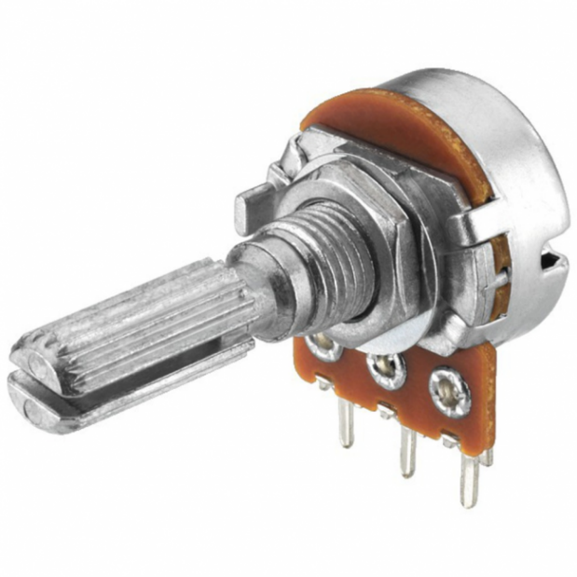
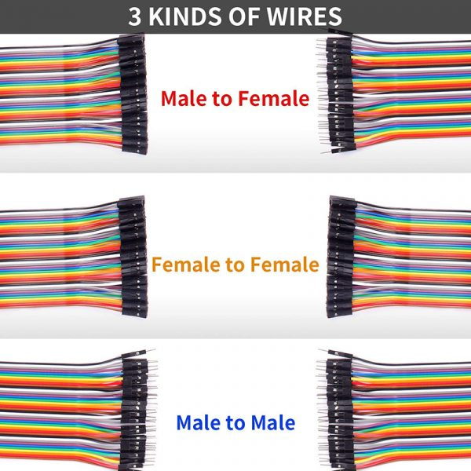
Jumper Wires and Potmeter:
A potentiometer is a three-terminal resistor with a sliding or rotating contact that forms an adjustable voltage divider. If only two terminals are used, one end and the wiper, it acts as a variable resistor or rheostat.
Potentiometer is essentially a voltage divider used for measuring electric potential.
Jumper wires are simply wires that have connector pins at each end, allowing them to be used to connect two points to each other without soldering. Jumper wires are typically used with breadboards and other prototyping tools in order to make it easy to change a circuit as needed.
A jumper is a tiny metal connector that is used to close or open part of an electrical circuit. It may be used as an alternative to a dual in-line package (DIP) switch. A jumper has two or more connecting points, which regulate an electrical circuit board.
: Taxi Fare Meter

Slide 16
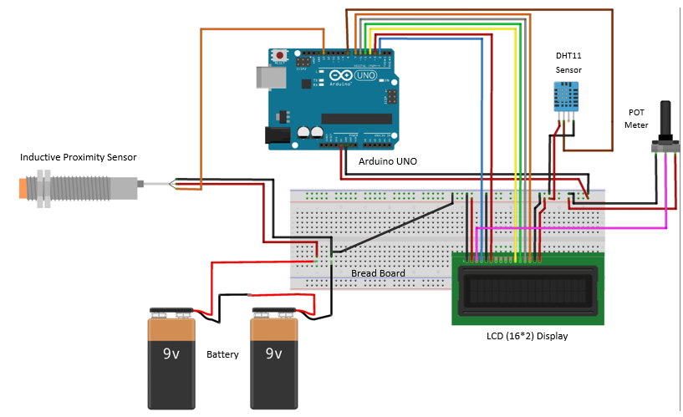
CIRCUIT DIAGRAM:
: Taxi Fare Meter

Slide 17

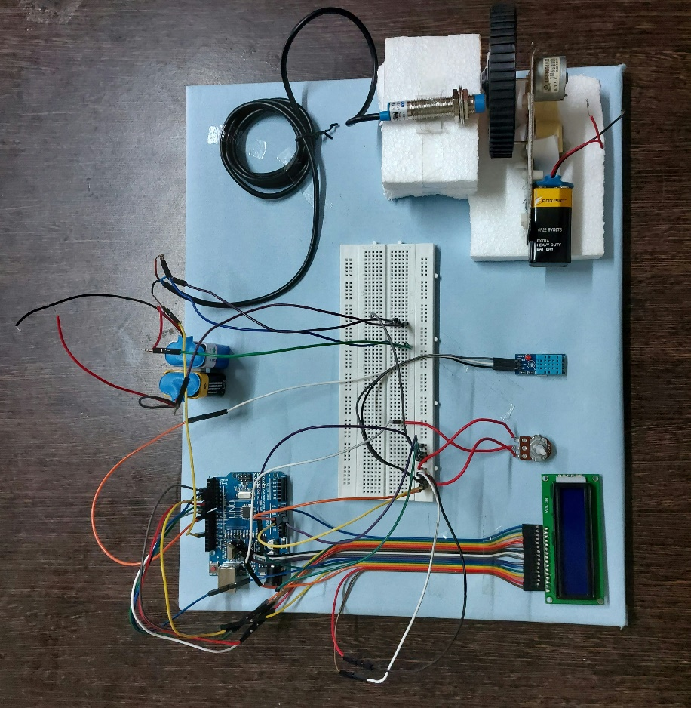



EXPECTED OUTCOME
The code must be dumped to Arduino UNO.
Then the output must be observed for Temperature and Humidity.
After displaying Temperature and Humidity, the vehicle starts to run and the wheel is said to be rotated.
By using Proximity Sensor the metal attached to the wheel is detected, and by using this we calculate distance.
Based on the Distance we calculate Fare Amount.
The Lcd interface must show the current temperature and Humidity with the running vehicle distance and Amount.
ECO-FRIENDLY
TEMPERATURE
SPEED AND DISTANCE
: Taxi Fare Meter

Slide 18
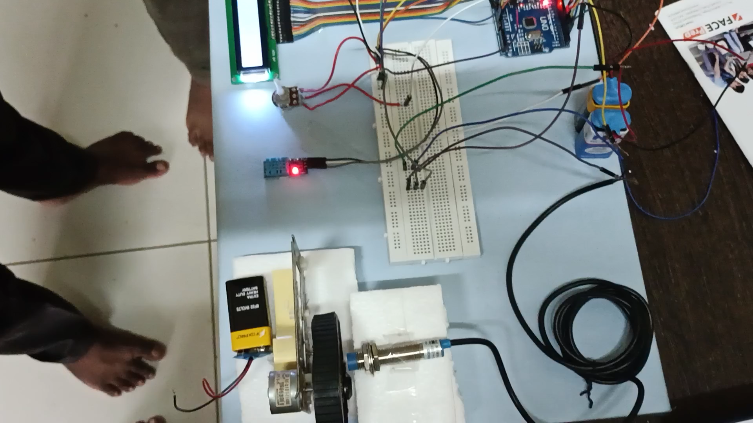

Slide 19
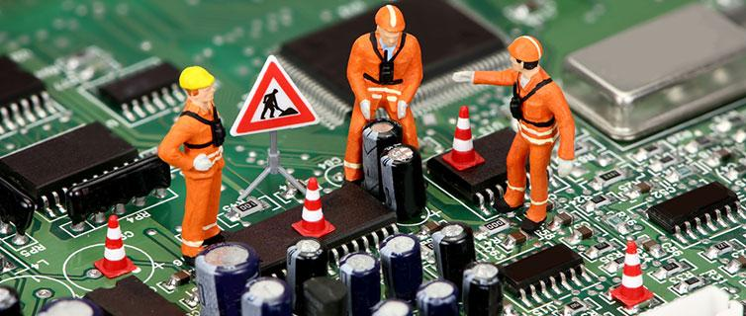
APPLICATIONS
It can be used widely at any Vehicles, depending upon the model used for Transportation.
The Temperature and Humidity can be represented very easily.
There is no misunderstanding in calculating the fare, and can avoid conflict.
Any Moment Distance can be observed.
It can be easily implemented in the Vehicles.
It can also be applicable for high speed vehicles.
: Taxi Fare Meter

Slide 20
CONCLUSION
Another advantage of system is that we used affordable yet efficient components in building it, therefore we can guarantee the drivers that they can afford to buy this system as well as providing them with better, working, and effective device.
The result can be obtained in any part of place.
: Taxi Fare Meter

Slide 21
THANK YOU
: Taxi Fare Meter

